Slide 1
Team Self Introduction
Smithsonian 26 Fall

Slide 2
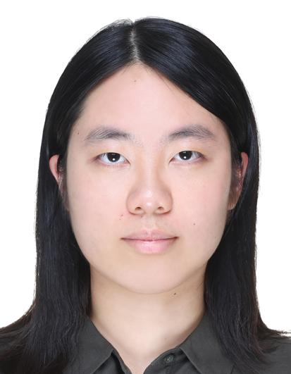
Team Member: Kimberly (Yun-Ying) Tsai
2nd Year Master of Computer Science
Interests: Playing Table Tennis, Watching Baseball, Movie
Fun Fact: I’m a Los Angeles Dodgers fan!

Slide 3
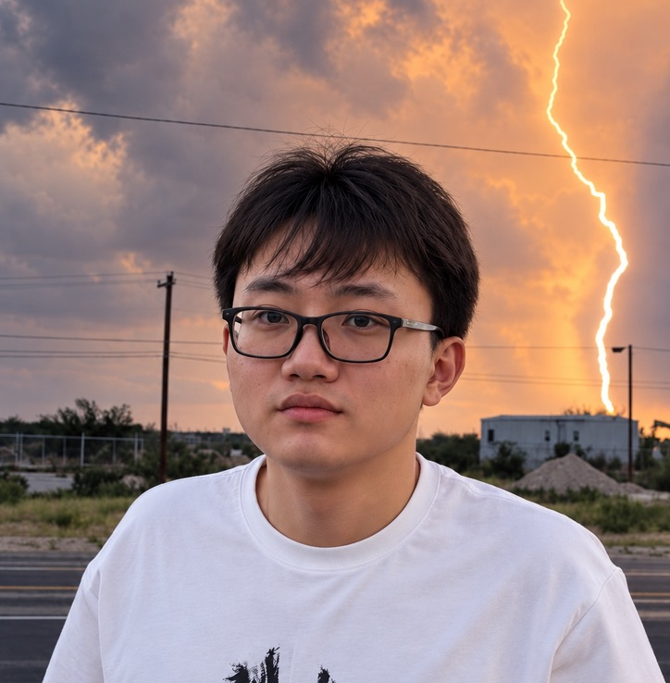
Team Member: Yunfan Bao (Bob)
Master of Data Science
Experience: Data engineer
Interests: Running, travel, vibe coding
Fun Fact: I’m an amateur pianist.

Slide 4
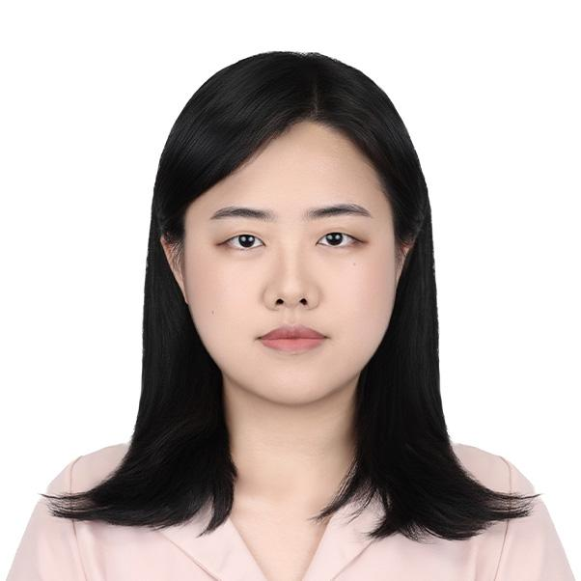
Team Member: YeonJu Kim
2nd Year Master of Data Science
Interests: Watching baseball, movies, live performances, and traveling
Fun Fact: Recently started learning to play the bass guitar

Slide 5
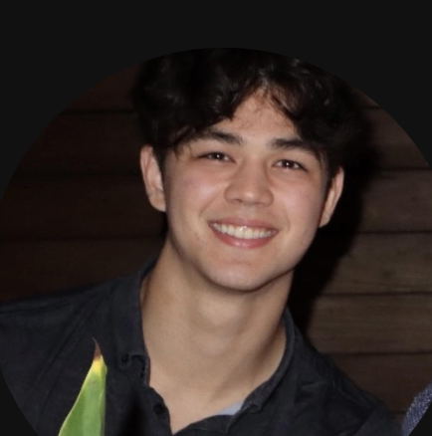
Team Member: Patrick Batsell
Senior Majoring in Operations Research and Statistics
Interests: Concerts, Pickleball, Video Games, Research
Fun Fact: I have 3 brothers who all went to Rice

Slide 6
Team Member: Alan Yang
Senior Majoring in CS and Statistics
Interests: Video Games, AI/LLMs, Startups
Fun Fact: I can make a realistic water drop sound

